Slide 1
Comparing Accuracy
Probabilistic Scoring
vs
Traditional Scoring
A consulting project for
Alan Malik, PhD
Patient Tools, Inc.
Lee Panter

Slide 2
Presentation Objectives
What were the client’s questions?
What analysis was performed?
What results were obtained from the analysis?
How (if at all) do these results answer the client’s questions?

Slide 3
Statement of Objectives

Slide 4
What questions/goals were originally provided?
First mathematically prove that probabilistic scoring is more accurate than conventional scoring.
Q1
Second mathematically prove that probabilistic scoring derived from a conventional scored validation dataset is essentially as accurate as using the original validation dataset and therefore still more accurate than conventional scoring.
Q2

Slide 5
What questions/goals were actually answered?
Compare probabilistic scoring accuracy to conventional scoring accuracy, measured against simulated response values generated using information in Patient Health Questionnaire Nine (PHQ9) data. Determine how accuracy comparisons vary as a function of training sample size.
RE-Q1
Mathematical proof not provided
Comparison of accuracy using sample-specific methods
RE-Q2
Possibly missed due to Type III error
Possibly addressed serendipitously

Slide 6
Background

Slide 7
Patient Health Questionnaire-Nine (PHQ9)
What is it?
What’s wrong with it?
Questionnaire “module”
Screening and monitoring mental disorders
Specific to 9 DSMV-IV depression criteria
Nine Questions
Responses: 0 - “not at all” to 3 - “nearly every day” ^{[1]}
Traditional method of classification:
Sum of Responses (0-27) --> Three Depression Classes
[0, 7) Not Clinically Depressed, [7, 10) Sub-threshold Depression, [10, 27] Major Depression
88% sensitive/specific
12% of responses-False Negative/Positives
Cost to healthcare systems
Wasted time, effort, concern
Clinical fatigue, and useless results ^{[2]}

Slide 8
Probabilistic Scoring - How can it help?
Increase Training Size
Improve Accuracy
Gaining Functionality
Early Determination
Removal of medical staffing needs (computer integrated administration)
Individualized, targeted responses and interventions
Outcomes relatable with additional Patient Questionnaires, and other condition measurements
Probabilistic Scoring classifications are training-sample specific
Probabilistic Scoring accuracy increases with training sample size
??
VS
Conventional Scoring based on a priori established threshold parameters (do not change with sample)
X

Slide 9
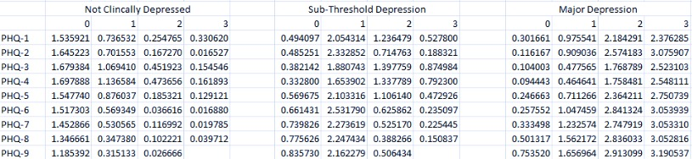
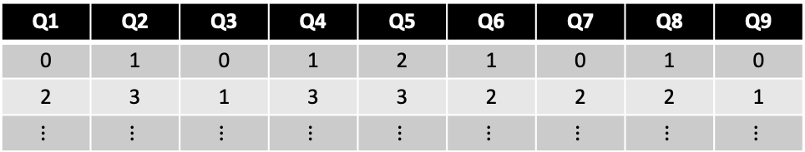
Probabilistic Scoring – How does it work?
PHQ9 Training Data
Q1 | Q2 | Q3 | Q4 | Q5 | Q6 | Q7 | Q8 | Q9
0 | 1 | 0 | 1 | 2 | 1 | 0 | 1 | 0
2 | 3 | 1 | 3 | 3 | 2 | 2 | 2 | 1
$$⋮$$ | $$⋮$$ | $$⋮$$ | $$⋮$$ | $$⋮$$ | $$⋮$$ | $$⋮$$ | $$⋮$$ | $$⋮$$
Probabilistic Scoring Weights
(Q#, RESP)
(Q1, 2)
(Q2, 2)
(Q3, 3)
(Q4, 3)
(Q5, 3)
(Q6, 2)
(Q7, 3)
(Q8, 0)
(Q9, 0)
Start Probs
(C1,C2,C3)=(1/3, 1/3, 1/3)
Pscore Algorithm to Classify New Observations
(0.26, 1.24, 2.18)◦(1/3, 1/3, 1/3) = (0.09, 0.41, 0.73)
⍺ (0.07, 0.33, 0.60)
New Observation
(0.07, 0.33, 0.60)◦(0.17, 0.72, 2.57)=(0.01, 0.24, 1.54)
⍺ (0.01, 0.13, 0.86)
Hadamard Product
Observation is C3 with 75% confidence after two iterations of the algorithm

Slide 10
Data
What’s in it?
What is used?
Where’s It from?
2495 observations
286 variables
Additional Testing Information
Quick Diagnostic Panel (QDP)
Demographic Information
Age and Gender
Record-keeping data
2495 observations
9 variables
All PHQ9 responses
Federally Qualified Health Research Center based in Montana
PHQ9s and QDPs collected
Six-month collection period
Tablet-administered (Ipad tablet)
What’s Missing?
VALIDATION MEASURES

Slide 11
Probabilistic Scoring
What do we want to show?
Probabilistic Classification accuracy increases with training sample size
At training samples large enough, Probabilistic Classification is just as or more accurate than Traditional Classification

Slide 12
Solution Principles

Slide 13
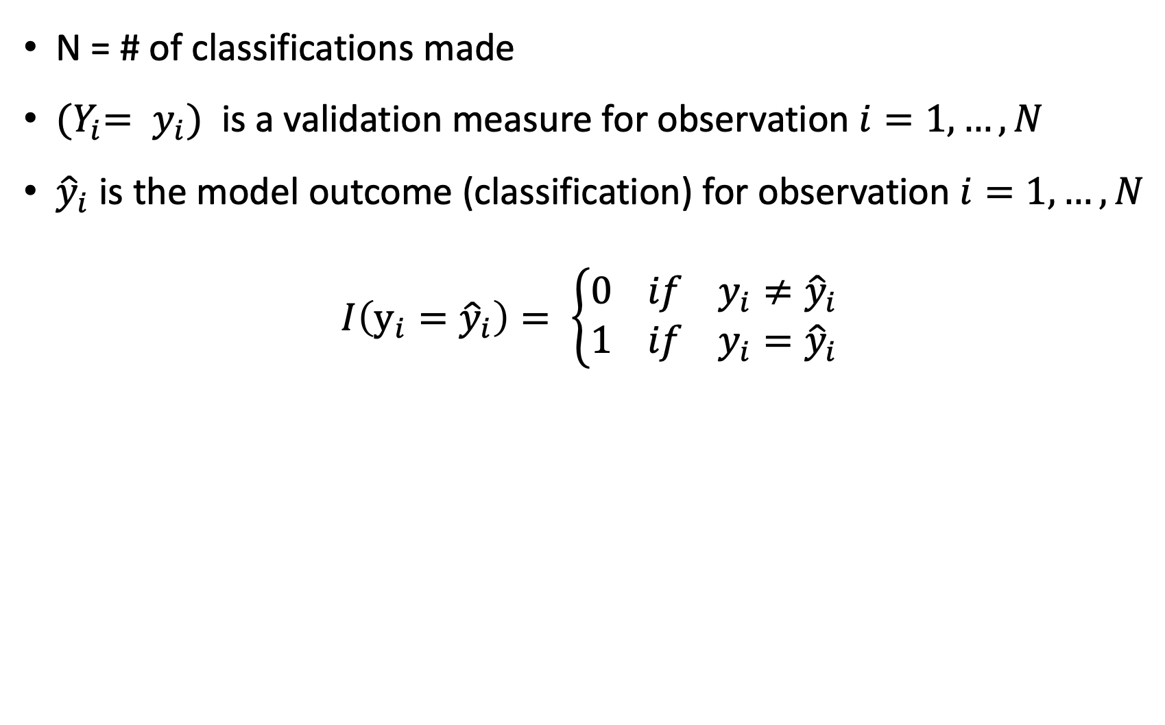
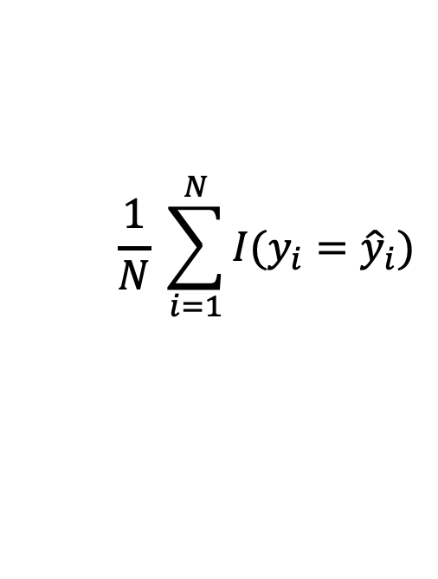
Measuring Accuracy
# correctly classified
$$\frac{1}{N} \sum_{i=1}^{N}{I(y_{i}={\hat{y}}_{i}})$$
Accuracy =
=
# of classifications attempted
Where:
N = # of classifications made
${{(Y}_{i}= y}_{i})$ is a validation measure for observation $i=1,…,N$
${\hat{y}}_{i}$ is the model outcome (classification) for observation $i=1,…,N$
$$I\left(y_{i}={\hat{y}}_{i}\right)= \left\{\begin{aligned}0 if y_{i}≠{\hat{y}}_{i} \\ 1 if y_{i}={\hat{y}}_{i}\end{aligned}\right.$$

Slide 14
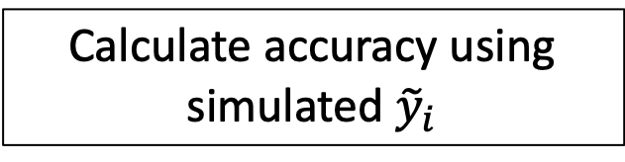
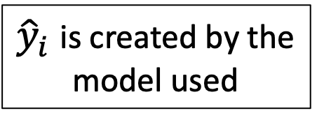
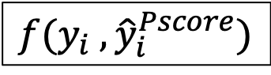
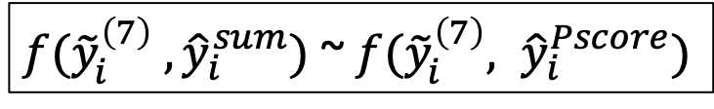
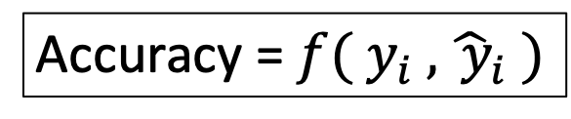
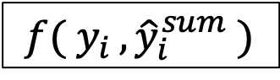
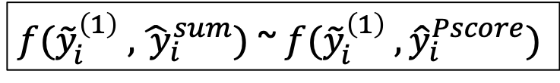
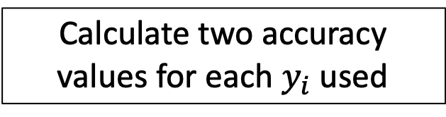
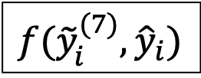
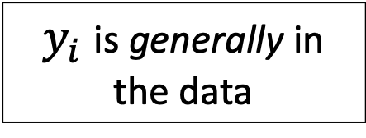
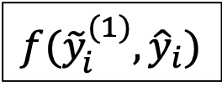
Validation Measures
Calculate two accuracy values for each $y_{i}$ used
We want to compare two models
$$f( y_{i },{\hat{y}}_{i}^{sum} )$$
$$f(y_{i} , {\hat{y}}_{i}^{Pscore})$$
${\hat{y}}_{i}$ is created by the model used
$f({\tilde{y}}_{i}^{\left(1\right)} ,{\hat{ y}}_{i}^{sum})$ ~ $f({\tilde{y}}_{i}^{\left(1\right)} , {\hat{y}}_{i}^{Pscore})$
Accuracy = $f( y_{i} , {\hat{ y}}_{i} )$
…
$y_{i}$ is generally in the data
$f({\tilde{y}}_{i}^{\left(7\right)} , {\hat{y}}_{i}^{sum})$ ~ $f({\tilde{y}}_{i}^{\left(7\right)}, {\hat{y}}_{i}^{Pscore})$
$$f({\tilde{y}}_{i}^{(1)}, {\hat{y}}_{i})$$
…
$$f({\tilde{y}}_{i}^{(7)}, {\hat{y}}_{i})$$
NOPE, not this time.
Simulate suitable validation sets using provided data
Calculate accuracy using simulated ${\tilde{y}}_{i}$

Slide 15
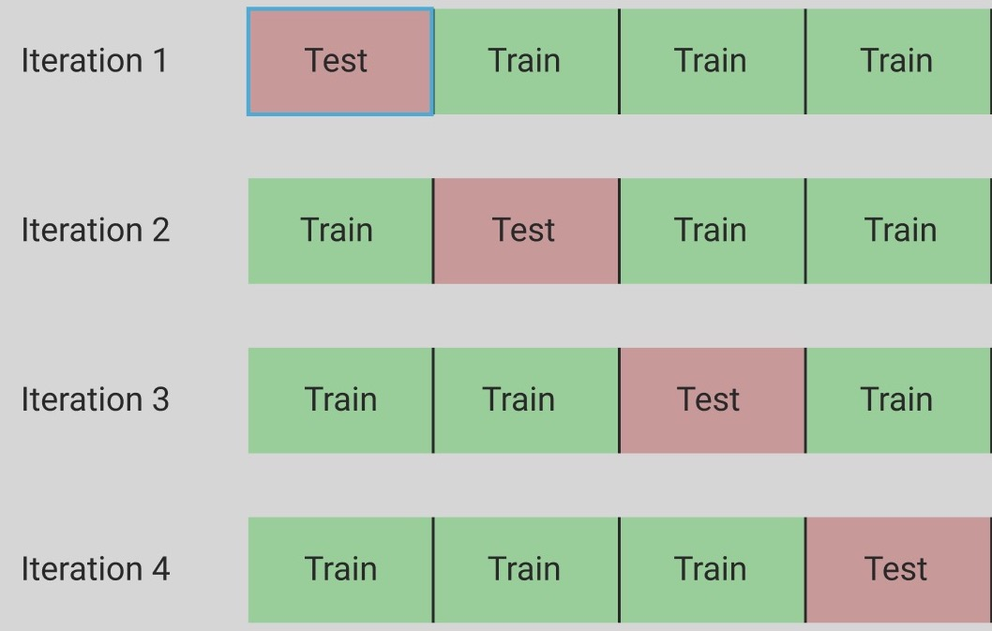
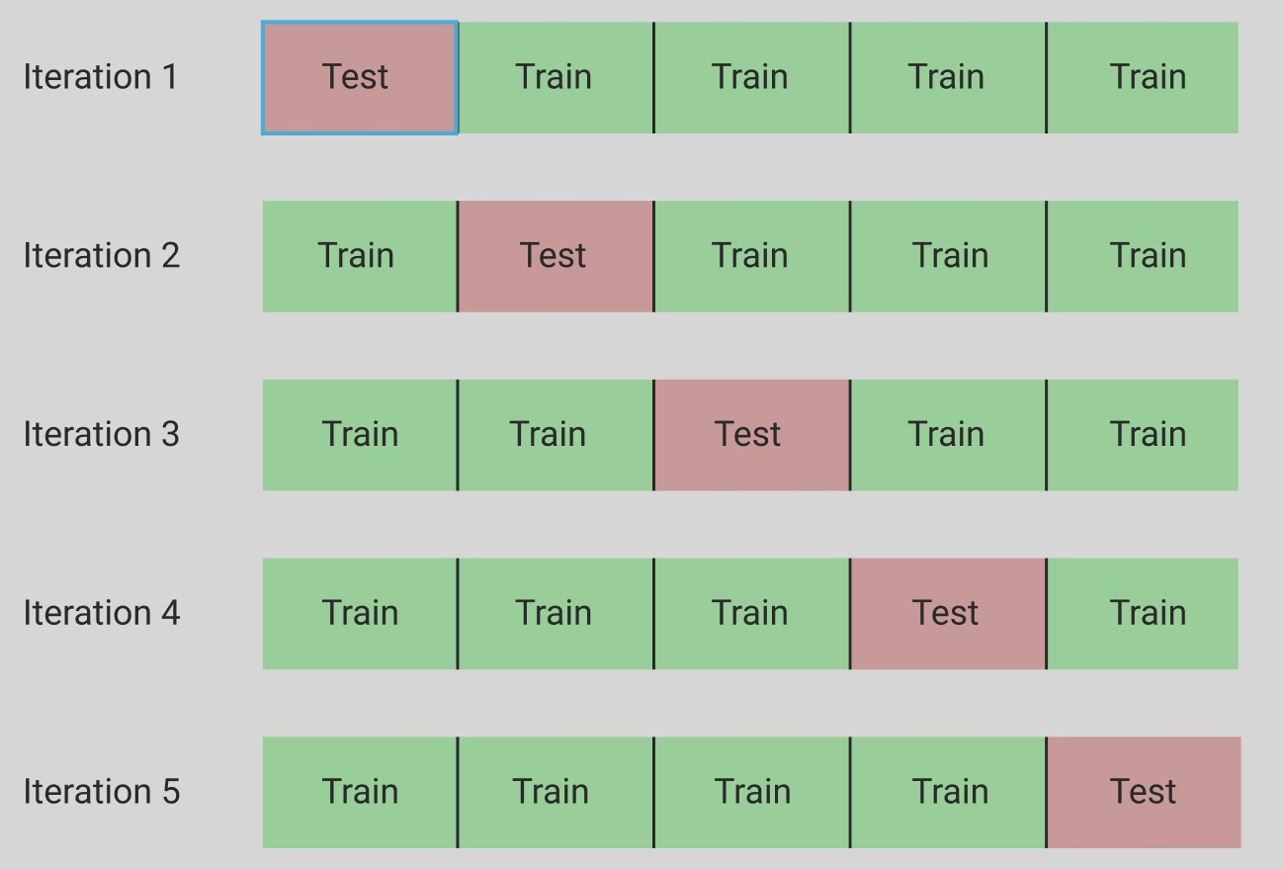
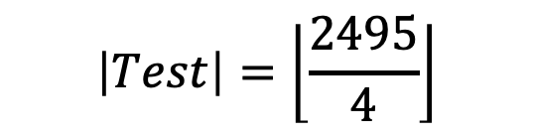
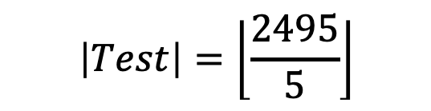
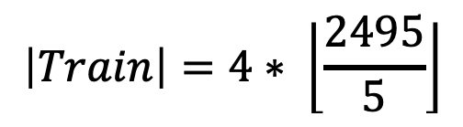
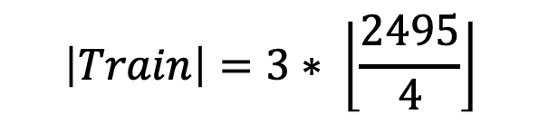
Evaluating Training Set Size Dependency
$$\left|Test\right|=\left\lfloor \frac{2495}{4}\right\rfloor$$
$$\left|Test\right|=\left\lfloor \frac{2495}{5}\right\rfloor$$
Test Sample Size:
Test Sample Size:
K=4
K=5
Training Sample Size:
$$\left|Train\right|=3∗ \left\lfloor \frac{2495}{4}\right\rfloor$$
Training Sample Size:
$$\left|Train\right|=4∗ \left\lfloor \frac{2495}{5}\right\rfloor$$

Slide 16
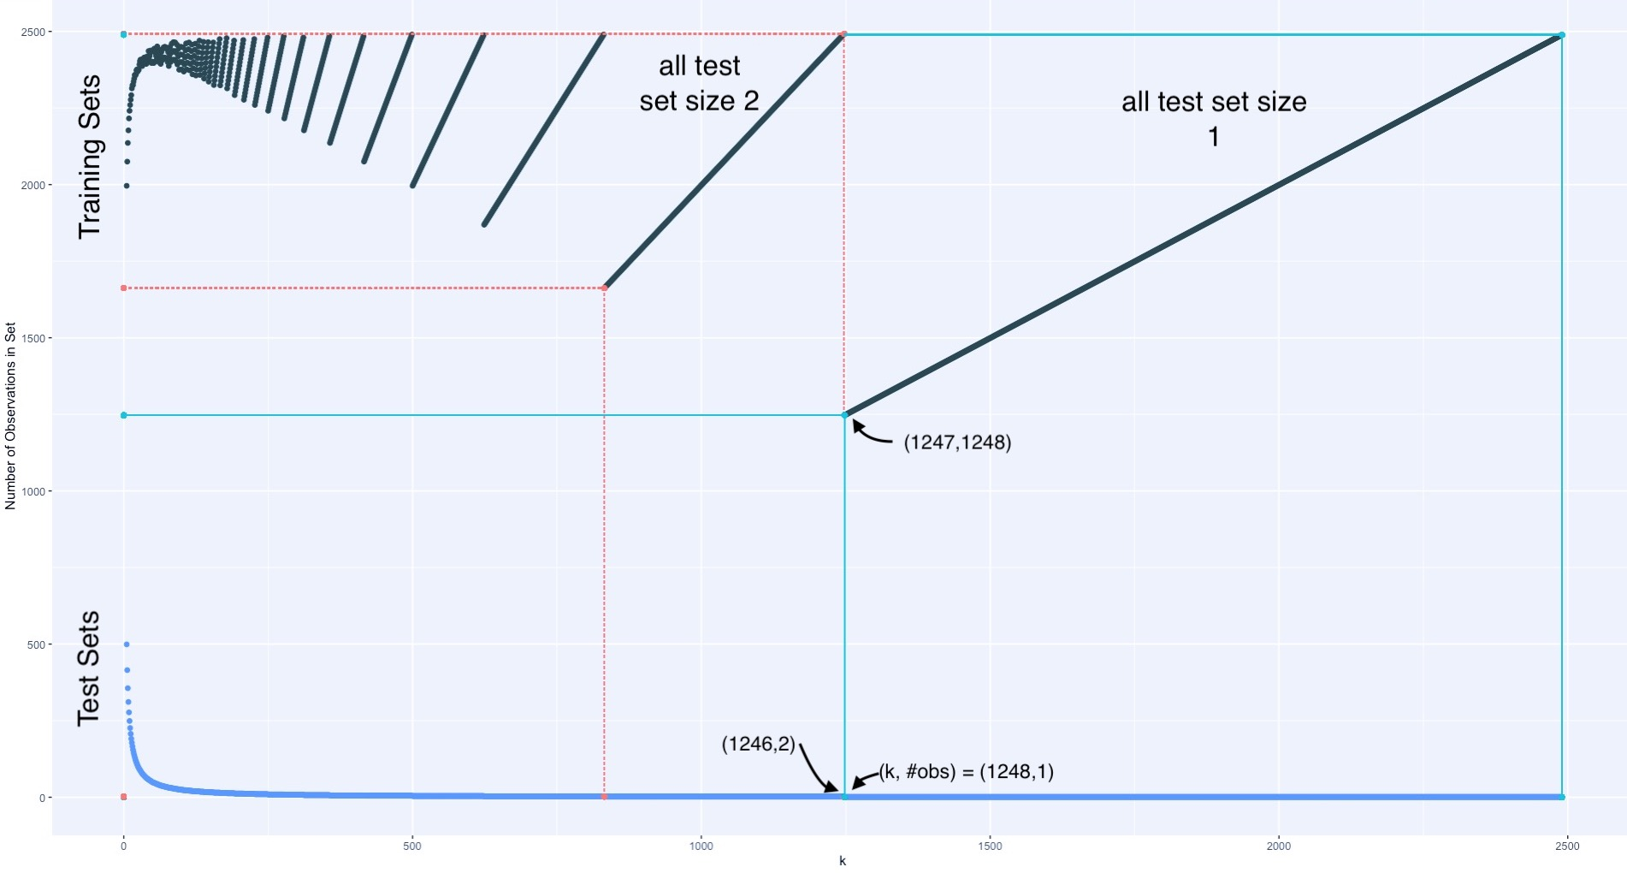
Evaluating Training Set Size Dependency

Slide 17
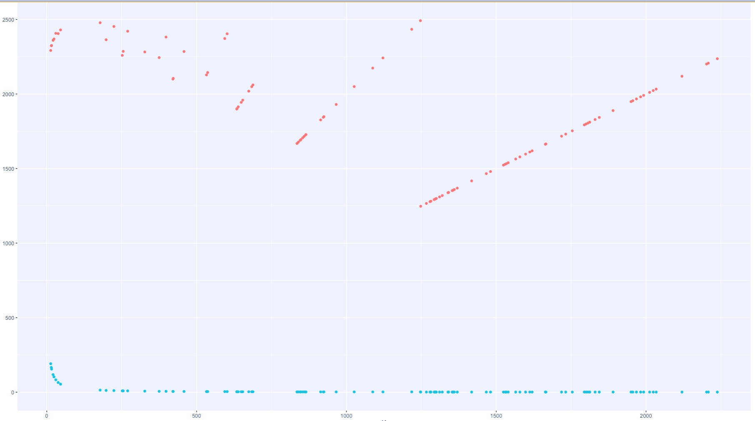
Evaluating Training Set Size Dependency
Observations
K

Slide 18
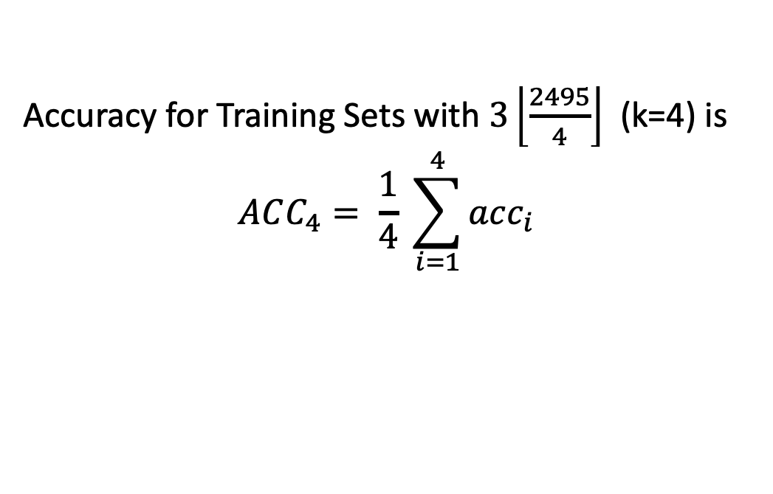
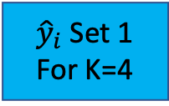
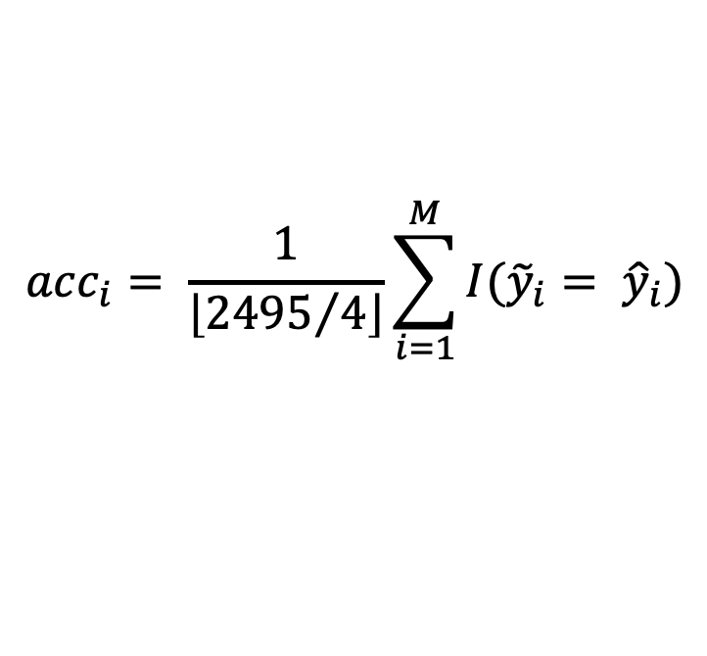
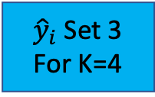
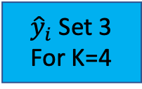
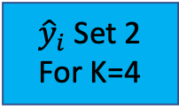
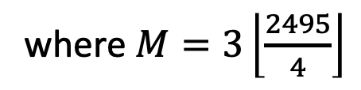
Accuracy Analysis of Probabilistic Scoring
Cross-Validation Process
Pscore Weight Set 1
Test Set 1
${\hat{y}}_{i}$Set 1
For K=4
Train Set 1
Pscore Weight Set 2
Test Set 2
${\hat{y}}_{i}$Set 2
For K=4
Train Set 2
Pscore Weight Set 3
${\hat{y}}_{i}$Set 3
For K=4
Train Set 3
Test Set 3
Train Set 4
Pscore Weight Set 4
Test Set 4
${\hat{y}}_{i}$Set 3
For K=4
Accuracy on Set=i with K=4
Accuracy for Training Sets with $3\left\lfloor \frac{2495}{4}\right\rfloor$ (k=4) is
$$ACC_{4}= \frac{1}{4} \sum_{i=1}^{4}{acc_{i}}$$
$$acc_{i}= \frac{1}{\left\lfloor {2495}/4\right\rfloor }\sum_{i=1}^{M}{I({\tilde{y}}_{i}= {\hat{y}}_{i})}$$
where $M=3\left\lfloor \frac{2495}{4}\right\rfloor$

Slide 19
Validation Measures
Manually Reconstructed Validation Set
Information obtained from data source:
Assumptions made for calculation of validation set:
Depression Classifications are a hierarchy:
grp(1) < grp(2) < grp(3)
12% mis-classification due to proximal class mis-diagnosis
Within each class, there is a spectrum of conditions
transitions between classes are essentially continuous
Traditional Scoring is 88% accurate in classifying provided data
Implemented threshold values: 7 & 10

Slide 20
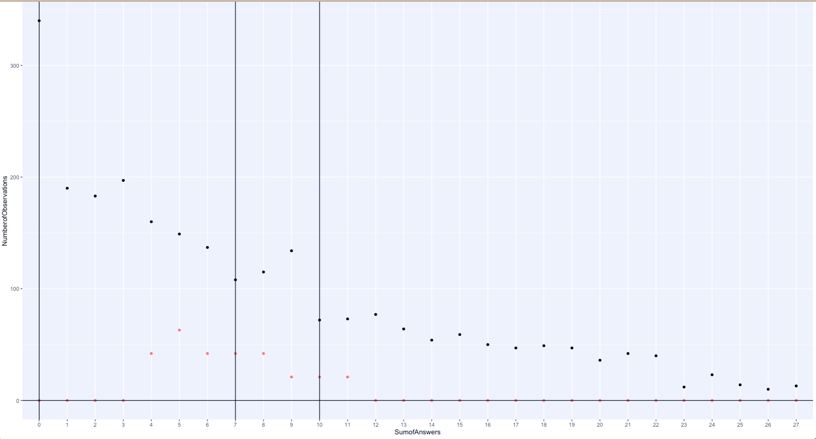
Validated Measures
Inferentially Generated Validation Set
# of observations “flipped” based on:
Proximity to a threshold
(harder to classify)
Number of observations within a category
More chances of being mis-classified
Flipped to C1
Half Flipped to C1 other Half to C3
Flipped to C2
Flipped to C2

Slide 21
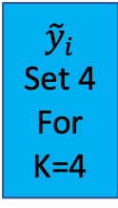
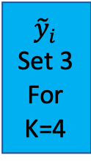
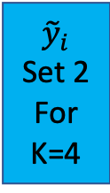
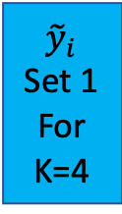
Validation Measures
Probabilistically Simulated Validation Measures ${(\tilde{y}}_{i})$
Train Set 1
Pscore Weight Set 1
Train Set 2
Pscore Weight Set 2
K=4 Average Pscore Weight Set
Train Set 3
Pscore Weight Set 3
Train Set 4
Pscore Weight Set 4
Test Set 1
Test Set 2
Test Set 3
Test Set 4
${\tilde{y}}_{i}$ Set 1
For K=4
${\tilde{y}}_{i}$ Set 2
For K=4
${\tilde{y}}_{i}$ Set 3
For K=4
${\tilde{y}}_{i}$ Set 4
For K=4

Slide 22
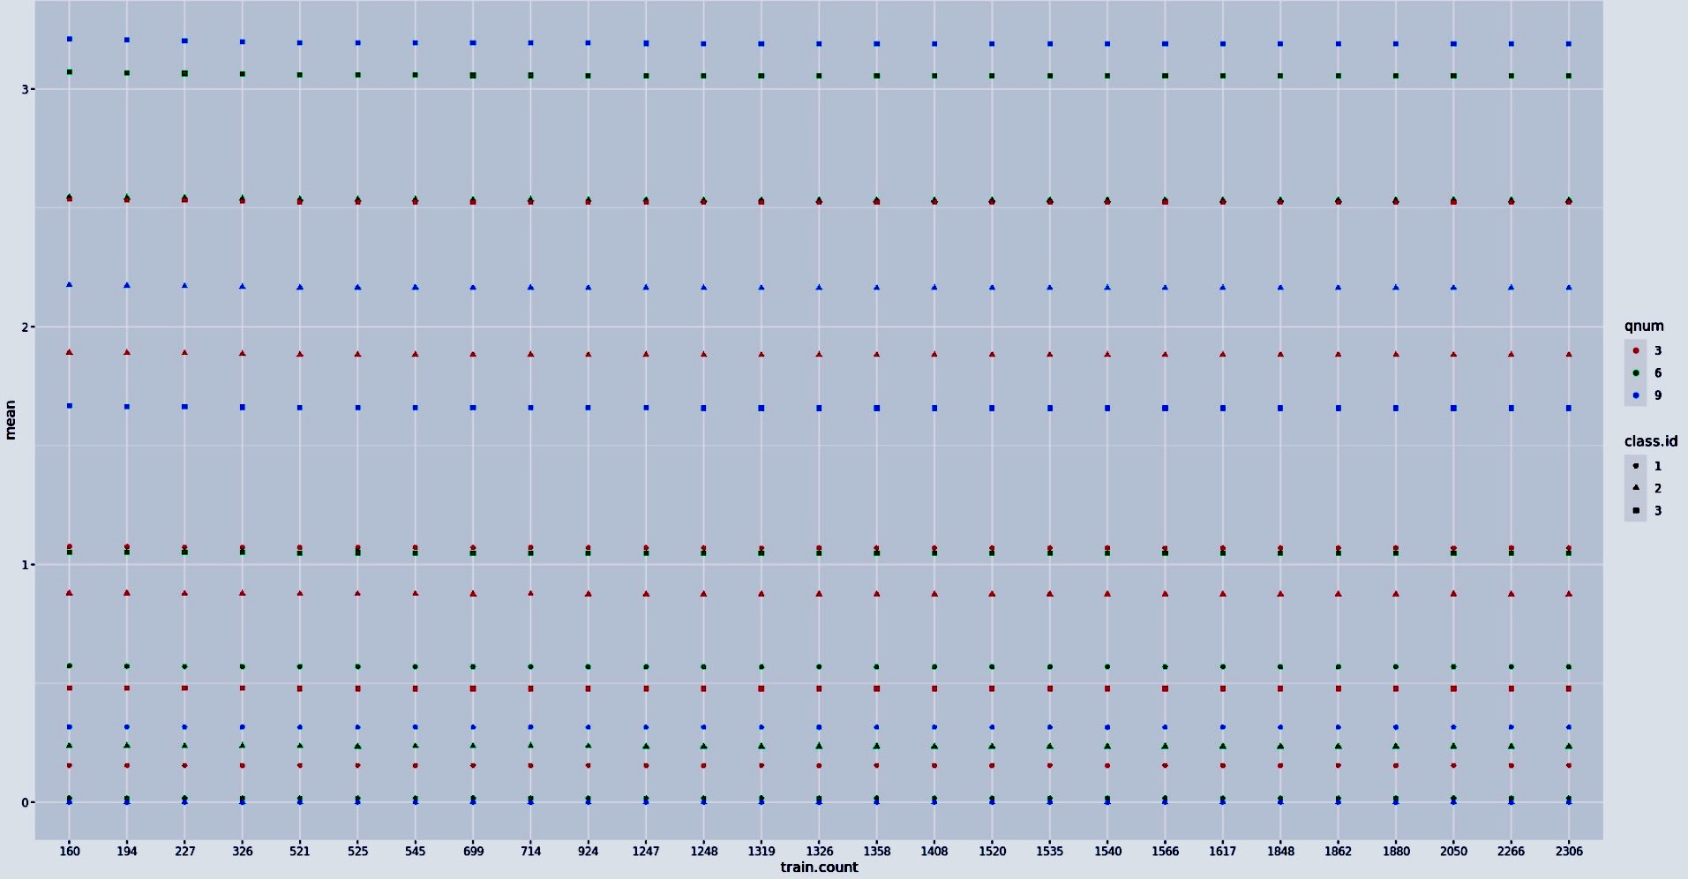
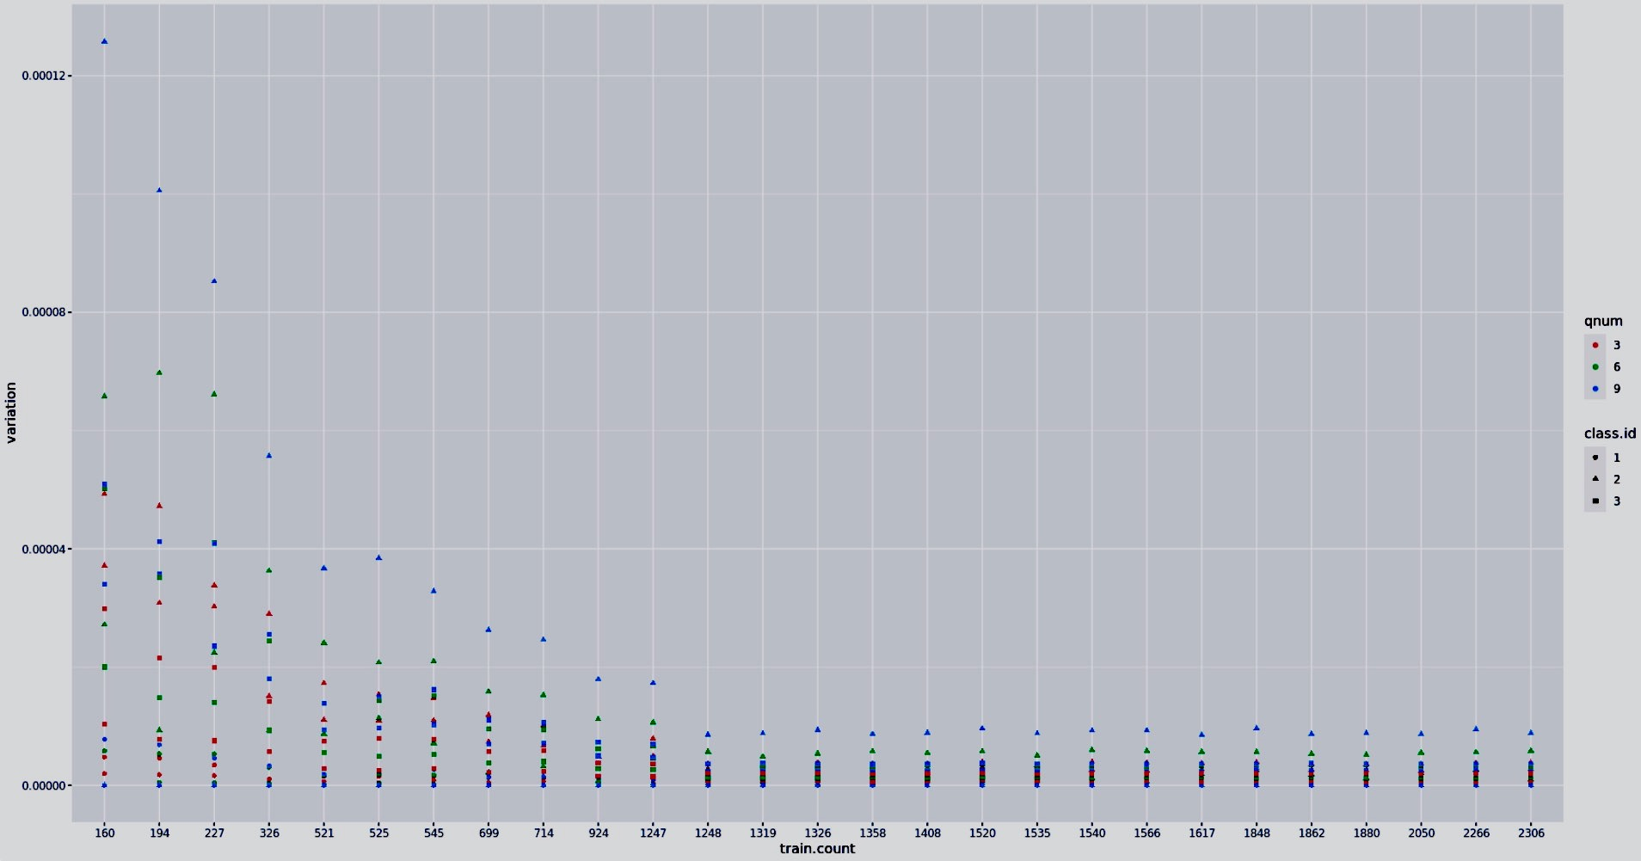
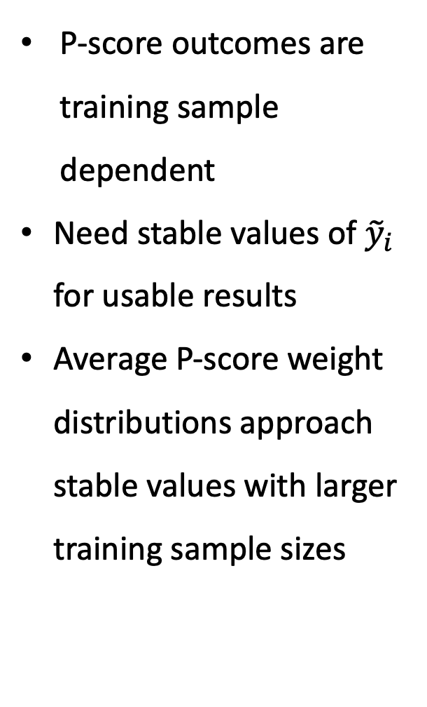
Validation Measures
Pscore Measures
P-score outcomes are training sample dependent
Need stable values of ${\tilde{y}}_{i}$ for usable results
Average P-score weight distributions approach stable values with larger training sample sizes

Slide 23
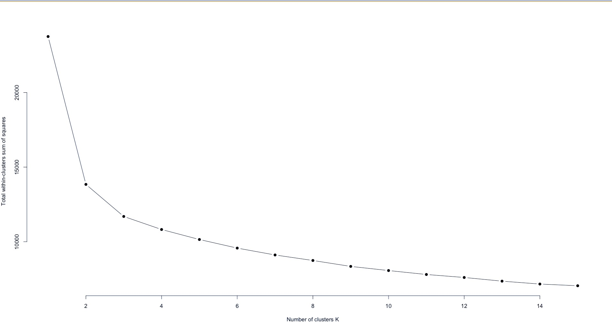
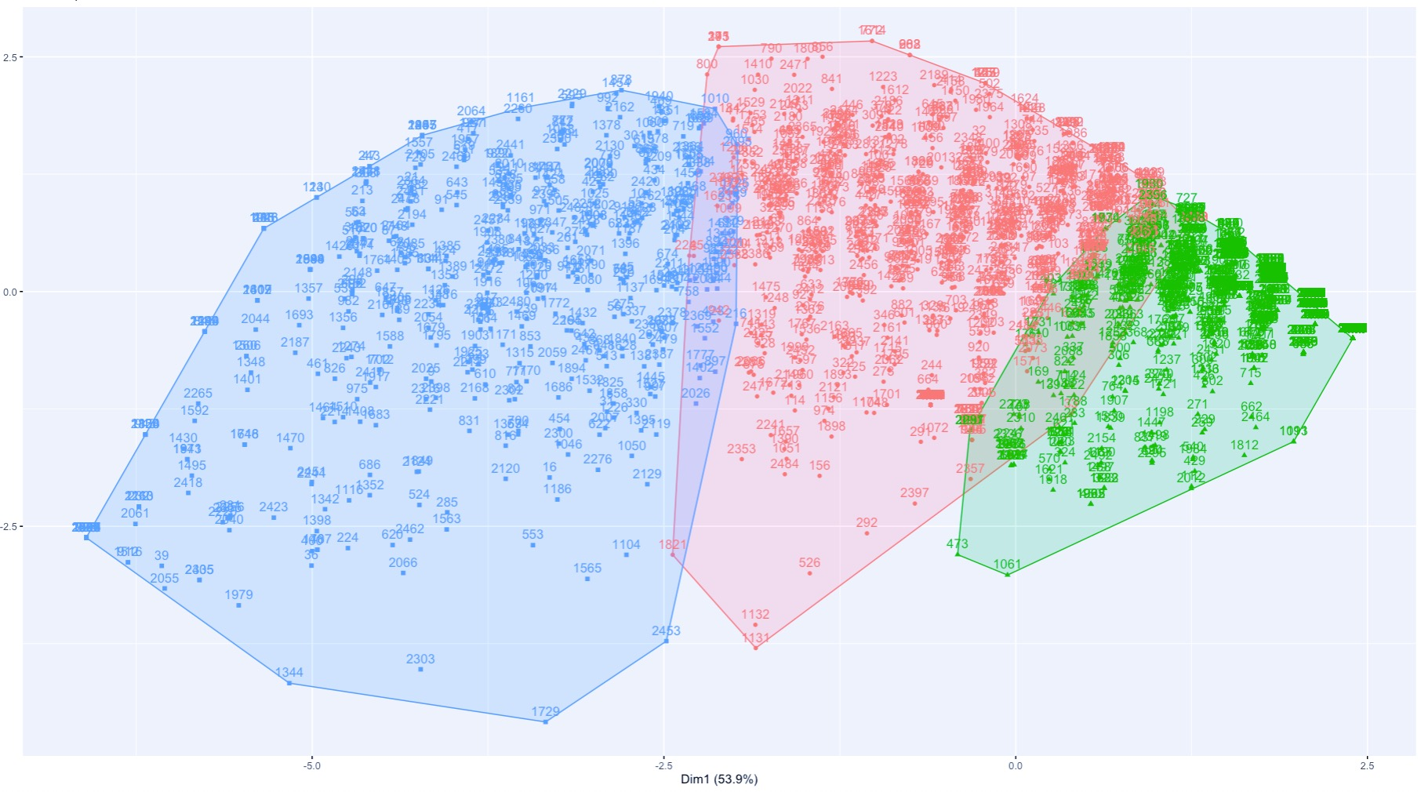
Validation Measures
K-means & Hierarchical Clustering

Slide 24
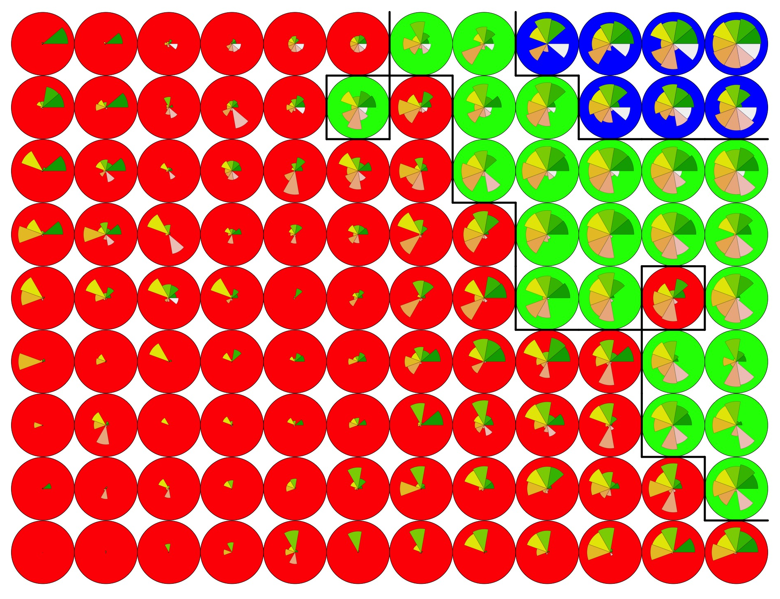
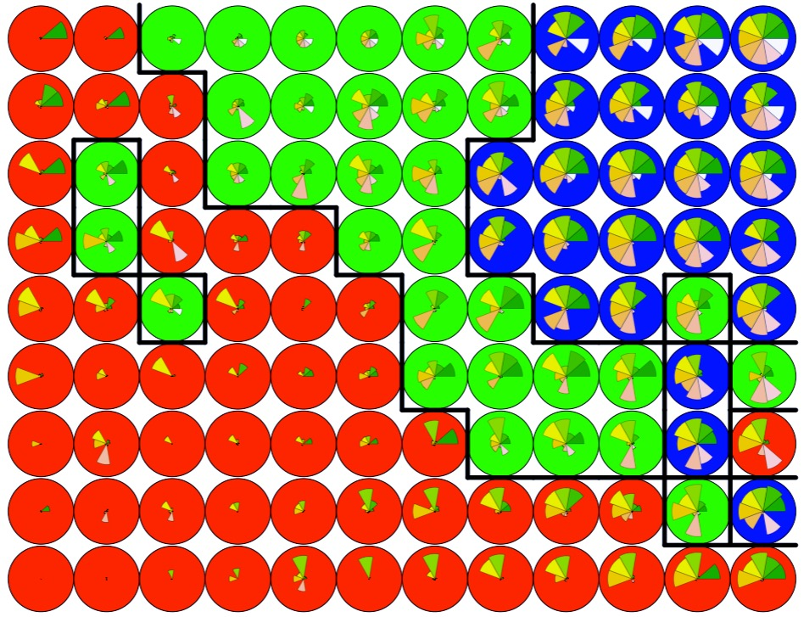
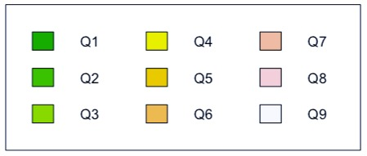
Validation Measures
Self-Organizing Maps 9 X 12
Euclidean Distance
Manhattan Distance

Slide 25
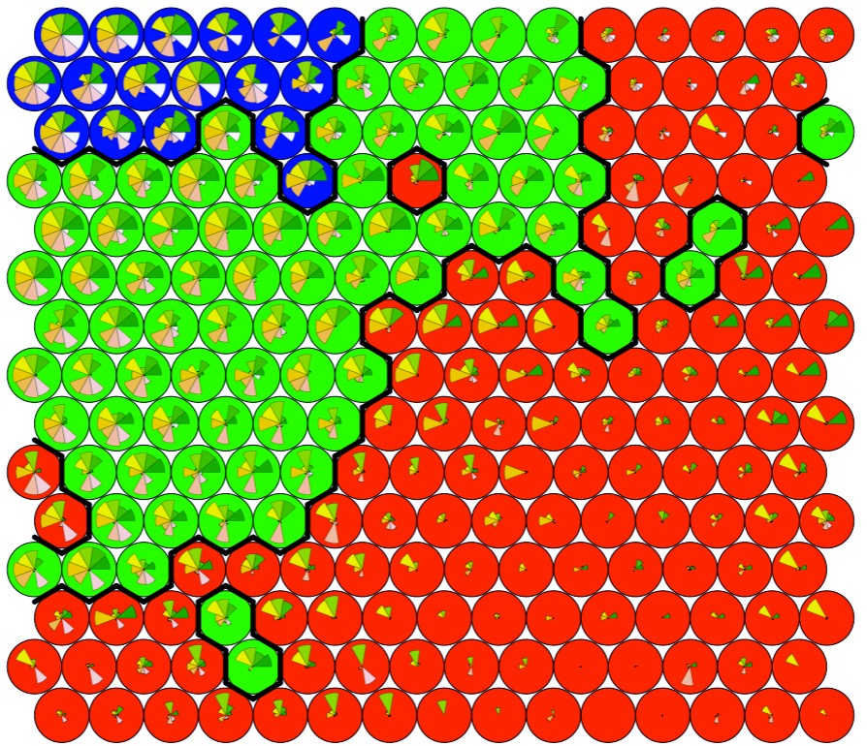
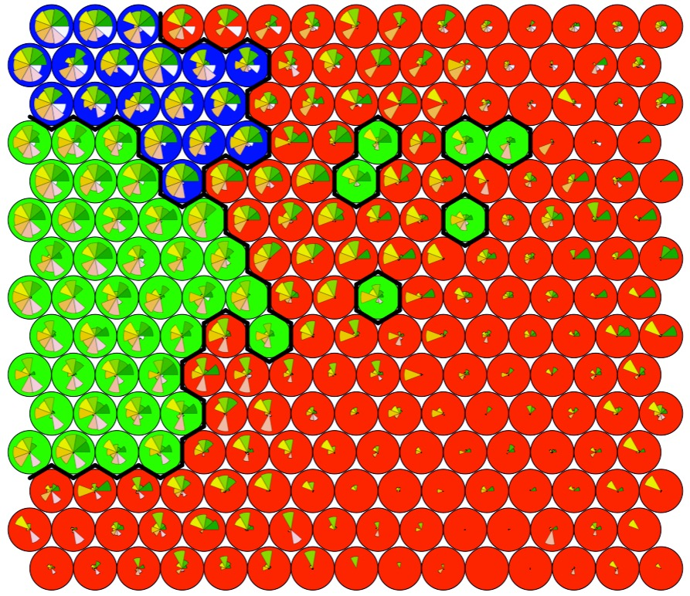
Validation Measures
Self-Organizing Maps 15 X 15
Euclidean Distance
Manhattan Distance

Slide 26
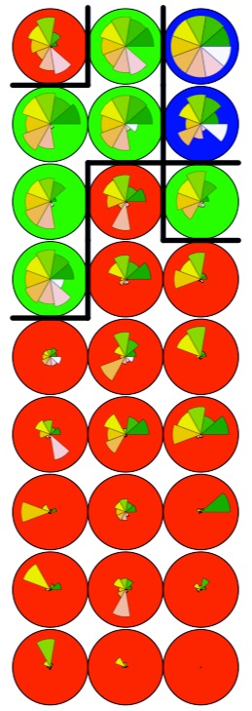
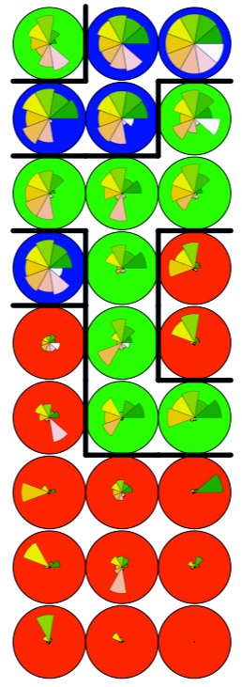
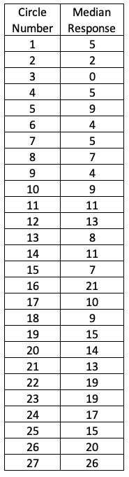
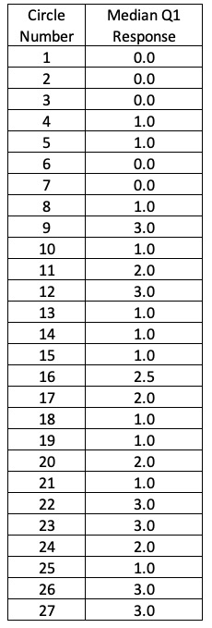
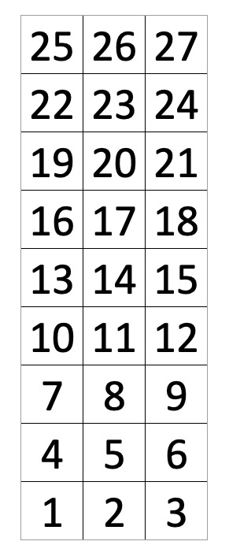
Validation Measures
Self-Organizing Maps 3 X 9
Answer Number
Euclidean Distance
Manhattan Distance

Slide 27
Results

Slide 28

Inferentially Generated Validation Set

Slide 29

Probabilistically Generated Validation Set

Slide 30


Kmeans and Hierarchical Clustering Outcomes
0.7
Traditional Classifications
Probabilistic Classifications
0.7
Kmeans Clustering
Hierarchical Clustering
Average CV Accuracy
0.4
Probabilistic Classifications
0.4
Traditional Classifications
2000
2100
Train Length
2400
2500
2000
2100
Train Length
2400
2500

Slide 31


Self Organizing Map Outcomes
Euclidean Distance
Manhattan Distance
0.95
0.40
Average CV Accuracy
Average CV Accuracy
0.70
0.36
Training Set Length
Training Set Length
Identical in Each Plot
Probabilistic classification
Traditional classification

Slide 32


Self Organizing Map Outcomes
15X15 SOM
0.53
Euclidean Distance
0.30
Average CV Accuracy
Average CV Accuracy
Manhattan Distance
0.15
0.48
Training Set Length
Training Set Length
Identical in this Plot
Identical in this Plot
Euclidean Distance
Manhattan Distance
Probabilistic classification
Traditional classification
Probabilistic classification
Traditional classification

Slide 33
Summary and Conclusions
Analysis Conducted
Comparison of classification accuracies: Pscoring vs Traditional Scoring
Measured against simulated validation/supervision sets
Evaluated for trends related to training sample size
Analysis Summaries
Several derived supervision sets linked to modeling approaches
Estimates are not comparable across modeling technique
Data lacks sufficient information needed to obtain conclusive comparisons of methods
Benefits of Probabilistic Scoring implementations promising

Slide 34

THANK YOU!
References

